Slide 1

COVID-19 CASES TRACKER
-V. ABHINAV
-B. SREE VARSHITHA
-N. AKIRA NANDAN
This Photo by Unknown author is licensed under CC BY-ND.

Slide 2
ABSTRACT
This is a simple GUI-based application that automatically generates the total number of covid cases either in any state of India or in any country both graphically and manually. This application is user-friendly, and the instructions would be clear in the application, the user must select the option to either view covid cases in India or in any other country. Then he would be given an option to view data in the form of graphs or just the manual data.
In this application we have implemented GUI using tkinter library and used other libraries like matplotlib to depict data graphically, beautifulsoup to scrape the data from the api’s, requests library to request data from the url’s and pandas library to manipulate data and to create data frames. This application is easy to understand and user friendly.
The main aim of this project is to provide information regarding the rising covid cases across the globe, so that the people will be aware of how the situation outside is. So, with this project we would be gaining knowledge regarding the implementation of different libraries such as tkinter, beautifulsoap, pandas, requests and matplotlib.

Slide 3
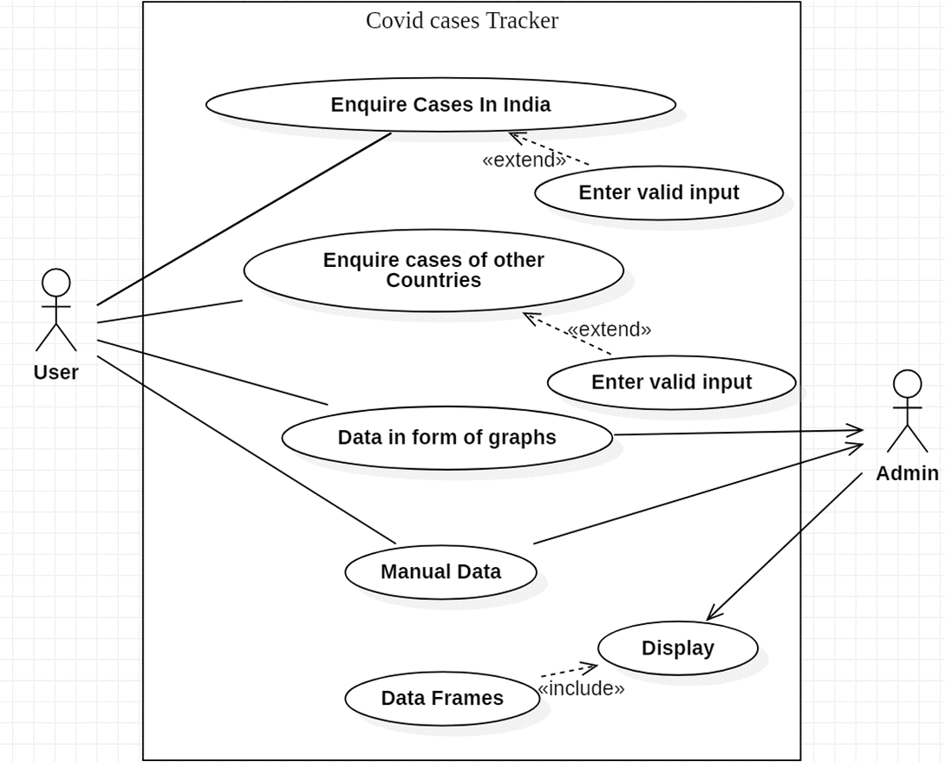
USE CASE DIAGRAM

Slide 4

TECHNOLOGY USED
Hardware Requirements:
512 MB RAM
2GB HDD
CORE i5
Software Requirements:
Windows XP/Windows 2000
PYTHON Interpreter
Packages used:
tkinter
BeautifulSoup
matplotlib
pandas
requests

Slide 5
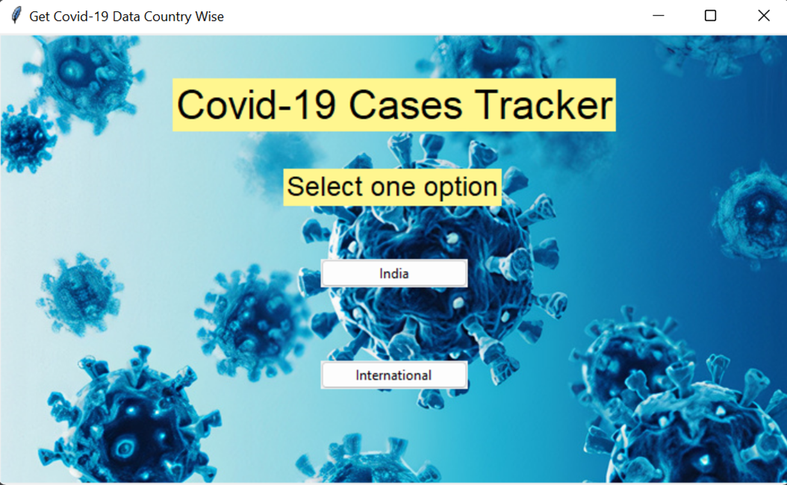
HOME PAGE

Slide 6
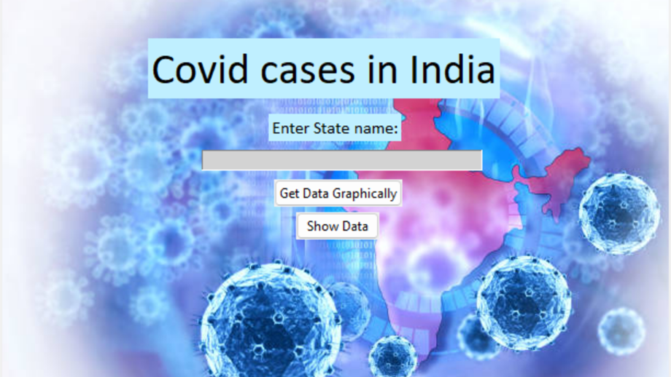
Upon choosing “India” option:

Slide 7
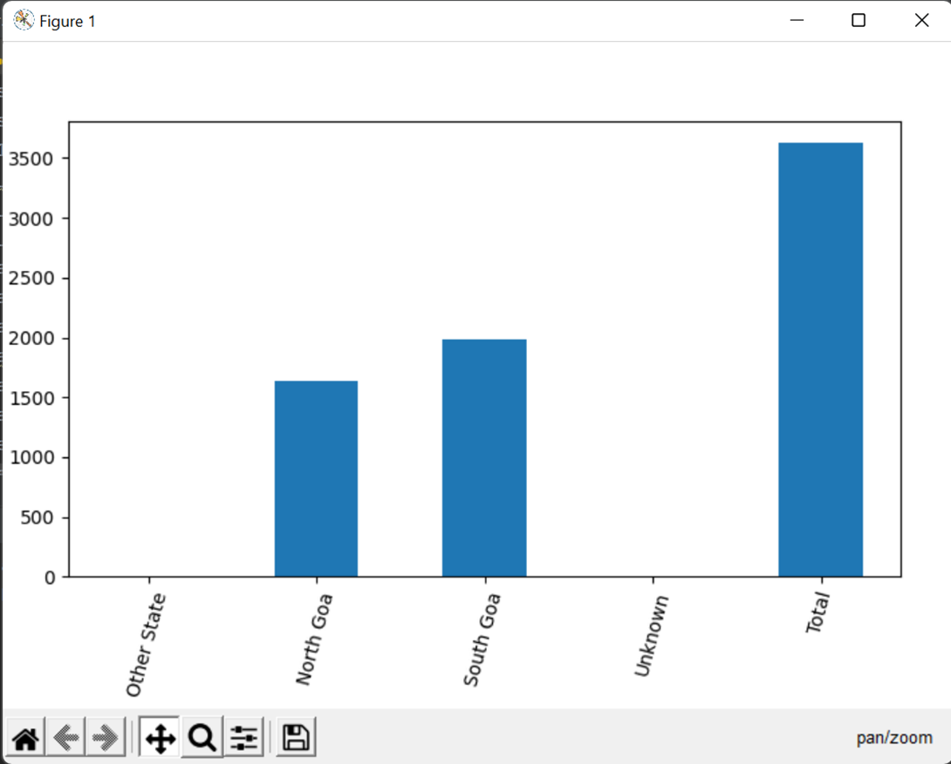
Upon choosing “Get Data Graphically” option for the state “Goa”:

Slide 8
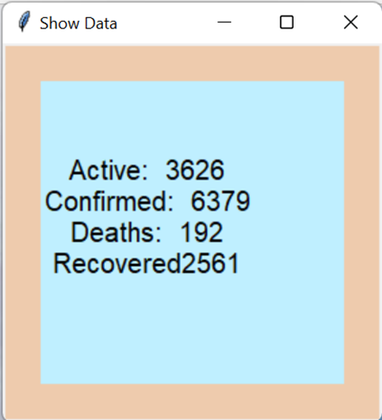
Upon choosing “Show Data” option for the same state “Goa”:

Slide 9
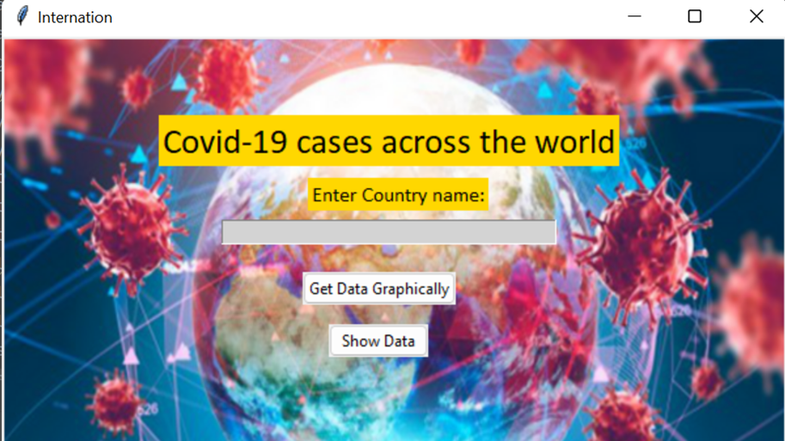
Upon choosing “International” option from the Home page:

Slide 10
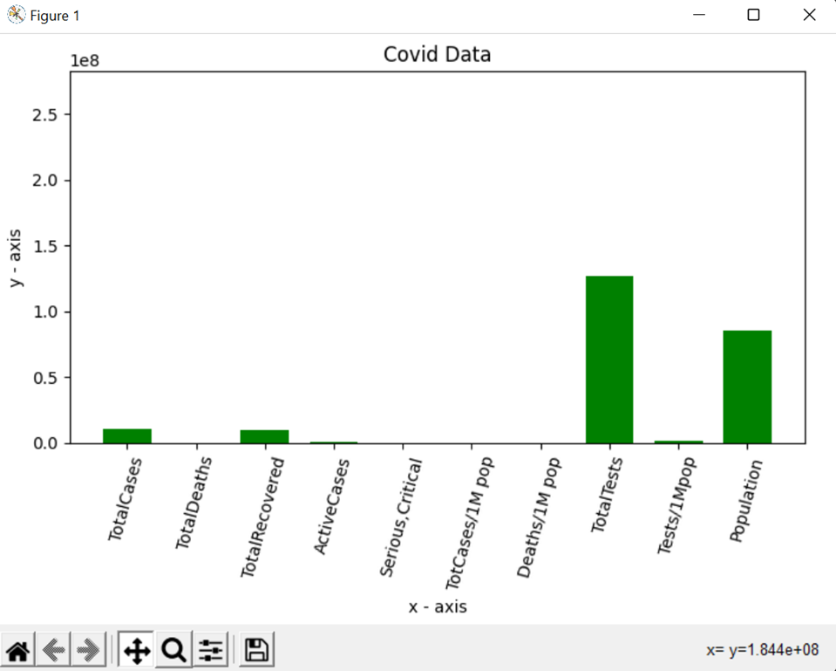
Upon choosing “Get Data Graphically” for the country “Turkey”:

Slide 11
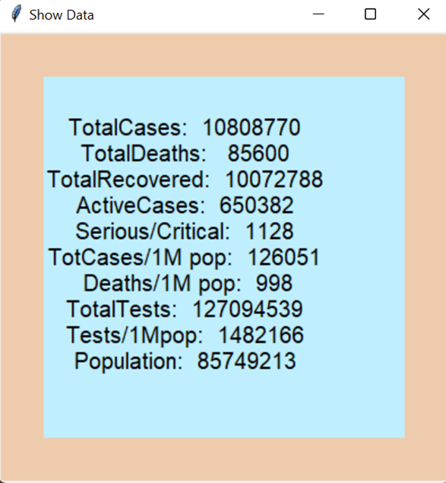
Upon choosing “Show Data” option for the same country “Turkey”:

Slide 12
CONCLUSION & FUTURE WORK
Covid-19 cases tracker is an informative GUI application which is based on Web Scraping. In future, we would like to make the application livelier by providing the required data using Django and Machine Learning, we would also try to make the application available for all platforms and depict data in more graphical manner using other plotting methods.

Slide 13

THANK YOU

